Slide 1
FAKE NEWS DETECTION USING NLP
by
JOHN ALLAN J
220701111
Guide

Slide 2

Introduction
Fake news is a big problem needing good detection methods. Traditional ways often fail against new tactics:
Logistic Regression (LR): Simple, interpretable. Uses keywords, language, source to spot fake news. Shows what matters most.
Machine Learning (ML): Learns complex patterns from lots of data (SVM, Random Forest, etc.). Aims for high accuracy.
Convolutional Neural Networks (CNNs): Can analyze text like images, finding subtle fake news clues, even in images.
Goal: Find the best way to fight fake news by checking how accurate, understandable, and usable different methods are. Considers cost, data needed, and adapting to new fake news styles.

Slide 3
Literature Survey
Fake News Today: Social media makes fake news harder to distinguish due to trust in familiar sources and declining trust in traditional media. It spreads easily because it often looks authentic.
Social Media's Role: "Echo chambers" on social media, driven by how we seek and share information and amplified by algorithms, trap users in limited perspectives, boosting fake news credibility and spread.
Defining Fake News Detection: Identifying fake news is a classification task (true/false or graded truthfulness), based on how fact-checkers label information.

Slide 4
Literature Survey
NLP for Detection: Natural Language Processing (NLP) is key to automatically identify fake news by analyzing text.
Machine Learning Application: Machine learning algorithms are used to learn from data and classify news as real or fake based on the extracted linguistic features.

Slide 5
Objectives
Goal: Create and test an NLP system to automatically detect fake news.
NLP Techniques: Explore different ways to extract text features (traditional, semantic, contextual).
ML Algorithms: Apply various machine learning classifiers (classical, ensemble, deep learning).
Data: Build and use relevant datasets for training and evaluation.
Outcome: Develop a strong and efficient model for classifying fake news accurately.
Further Analysis: Study important language features, model interpretability, and how well the model generalizes.
Potential Extensions: Possibly create a user interface or integration.

Slide 6
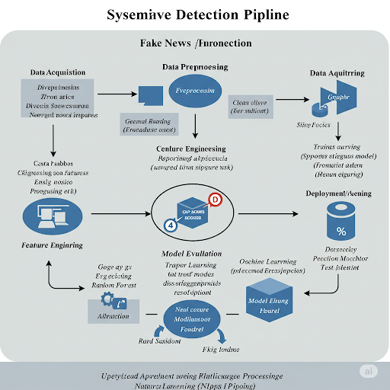
System Architecture

Slide 7
Methodology
Collect and preprocess data using techniques like normalization, encoding, and train-test splitting.
Build and train Logistic Regression and CNN models on the processed dataset.
Evaluate model performance using accuracy, precision, recall, and F1-score.
Compare results to determine the better model based on performance and interpretability.
Evaluated model performance using accuracy, precision, recall, and F1-score on the test set.

Slide 8
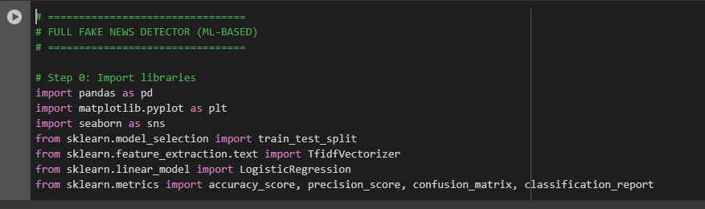
Implementation
Import Libraries

Slide 9
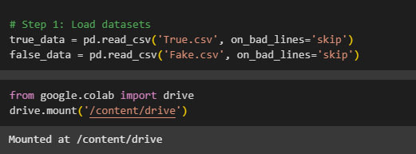
Implementation
Dataset:

Slide 10
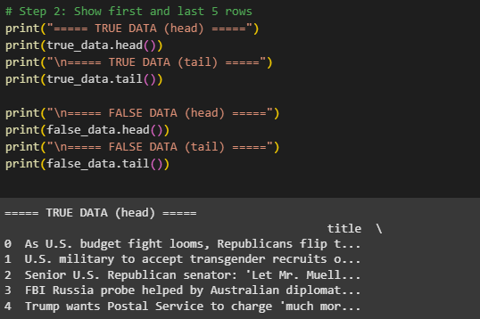
Implementation
Show first & last 5 rows

Slide 11
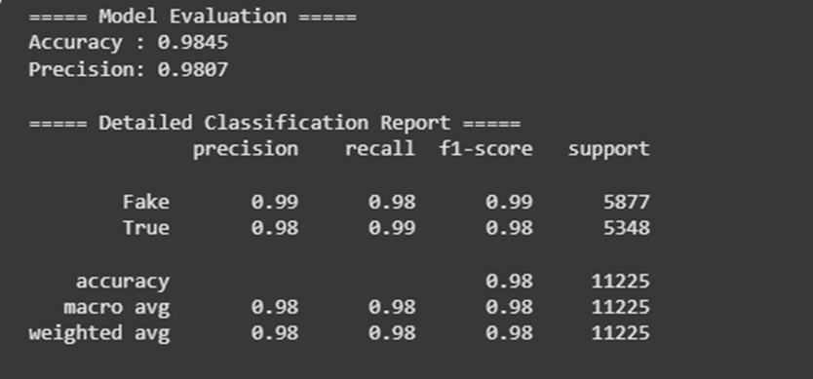
Implementation
Accuracy

Slide 12
Result
OUTPUT

Slide 13
Comparison with existing work
Direct Model Comparison: This research uniquely compares an interpretable model (Logistic Regression) directly with a high-performance deep learning model (CNN) for fake news detection, offering insights into the interpretability-performance trade-off.
2. Focus on CNNs & Comprehensive Evaluation: While some work may overlook deep learning or CNNs specifically for text-based fake news, this project emphasizes their evaluation alongside traditional methods for a more comprehensive understanding..

Slide 14
Conclusion and Future Work
Conclusion
This research successfully built an NLP-based system to automatically detect fake news. It tested various ways to extract text features (traditional to advanced) and compared different machine learning models (classical to deep learning). ¹ The findings highlight NLP's potential and the strengths/weaknesses of each approach in tackling online misinformation.
Future work
Future work should focus on multi-modal and temporal analysis, source credibility, and explainable AI for better fake news detection. Enhancing robustness against attacks, enabling cross-lingual detection, and achieving real-time analysis with user feedback are also crucial. Ultimately, these advancements will create more accurate and trustworthy systems.

Slide 15
Reference
1. de Oliveira, N.R.; Medeiros, D.S.V.; Mattos, D.M.F. A Sensitive Stylistic Approach to Identify Fake News on Social Networking.
IEEE Signal Process. Lett. 2020, 27, 1250–1254. [CrossRef]
2. Liu, G.; Wang, Y.; Orgun, M.A. Quality of trust for social trust path selection in complex social networks. In Proceedings of the 9th
International Conference on Autonomous Agents and Multiagent Systems; International Foundation for Autonomous Agents and
Multiagent Systems, Toronto, ON, Canada, 9–13 May 2010; pp. 1575–1576.
3. Vosoughi, S.; Roy, D.; Aral, S. The spread of true and false news online. Science 2018, 359, 1146–1151. [CrossRef] [PubMed]
4. Zhou, X.; Zafarani, R. A Survey of Fake News: Fundamental Theories, Detection Methods, and Opportunities. ACM Comput.
Surv. 2020, 53. [CrossRef]
5. Wang, W.Y. “Liar, liar pants on fire”: A new benchmark dataset for fake news detection. In Proceedings of the 55th Annual
Meeting of the Association for Computational Linguistics, Association for Computational Linguistics, Vancouver, BC, Canada, 30

Slide 16
THANK YOU

